Slide 1

ECE 2700
Digital Circuits
RTL Design in Verilog
RTL Design Exercises
Copyright © 2010 Frank Vahid
Instructors of courses requiring Vahid's Digital Design textbook (published by John Wiley and Sons) have permission to modify and use these slides for customary course-related activities, subject to keeping this copyright notice in place and unmodified. These slides may be posted as unanimated pdf versions on publicly-accessible course websites.. PowerPoint source (or pdf with animations) may not be posted to publicly-accessible websites, but may be posted for students on internal protected sites or distributed directly to students by other electronic means. Instructors may make printouts of the slides available to students for a reasonable photocopying charge, without incurring royalties. Any other use requires explicit permission. Instructors may obtain PowerPoint source or obtain special use permissions from Wiley – see http://www.ddvahid.com for information.

Slide 2
Today’s Objectives
To have an idea on how to create an HLSM in Verilog
To gain more practice in designing an HLSM

Slide 3
HLSM in Verilog
Same two-procedure approach as FSM
  One for combinational logic, one for registers
    Registers now include explicit registers (storage registers)
    Two reg variables per explicit register (current and next), just like for state register
`timescale 1 ns/1 ns
module LaserTimer(B, X, Clk, Rst);
input B;
output reg X;
input Clk, Rst;
parameter S_Off = 0,
S_On = 1;
reg [0:0] State, StateNext;
reg [1:0] Sreg, SregNext;
// CombLogic
always @(State, Sreg, B) begin
...
end
// Regs
always @(posedge Clk) begin
...
end
endmodule
FSM
inputs
b
x
HLSM
inputs
B
FSM
outputs
X
HLSM
outputs
Combinational
logic
Combinational
logic
State
State
Sreg
clk
State register
State register
Clk
Storage register
StateNext
StateNext
SregNext

Slide 4
HLSM in Verilog
...
reg [0:0] State, StateNext;
reg [1:0] Cnt, CntNext;
// CombLogic
always @(State, Cnt, B) begin
case (State)
S_Off: begin
X <= 0;
CntNext <= 2;
if (B == 0)
StateNext <= S_Off;
else
StateNext <= S_On;
end
S_On: begin
X <= 1;
CntNext <= Cnt - 1;
if (Cnt == 0)
StateNext <= S_Off;
else
StateNext <= S_On;
end
endcase
end
...
Combinational logic
  Describe actions and
  transitions
Inputs: B; Outputs: X;
Register: Cnt(2)
Note: Writes are to "next" variable, reads are from "current" variable. See target architecture to understand why.
X=0
Cnt=2
Off
B'
Cnt=0
B
X=1
Cnt=Cnt-1
On
(Cnt=0)'
HLSM
inputs
B
X
HLSM
outputs
Combinational
logic
State
Cnt
Clk
State register
Cnt register
StateNext
CntNext

Slide 5
HLSM in Verilog
Regs process
  Updates registers on rising clock
Inputs: B; Outputs: X;
Register: Cnt(2)
X=0
Cnt=2
...
// Regs
always @(posedge Clk) begin
if (Rst == 1 ) begin
State <= S_Off;
Cnt <= 0;
end
else begin
State <= StateNext;
Cnt <= CntNext;
end
end
...
Off
B'
Cnt=0
B
X=1
Cnt=Cnt-1
On
(Cnt=0)'
HLSM
inputs
B
X
HLSM
outputs
Combinational
logic
State
Cnt
Clk
State register
Cnt register
StateNext
CntNext

Slide 6
Alternative: Top-Down Design
Inputs: B; Outputs: X;
Register: Cnt(2)
X=0
Cnt=2
Off
B'
Cnt=0
B
X=1
Cnt=Cnt-1
On
(Cnt=0)'
Inputs: B, Cnt_Eq_0; Outputs: X, Cnt_Sel, Cnt_Ld;
Datapath
X=0
"10"
Cnt_Sel=1, Cnt_Ld=1
Cnt_Sel
2x1
-1
Off
B'
="00"
1
0
Cnt_Eq_0
Cnt_Eq_0
B
X=1
Cnt_Ld
Cnt_Sel=0, Cnt_Ld=1
Ld
Cnt
On
Clk
(Cnt_Eq_0)'
Controller

Slide 7
One-Procedure State Machine Desc.
One procedure per HLSM
  One variable per register
Simpler code with clear grouping of functionality
But may change timing
...
module LaserTimer(B, X, Clk, Rst);
...
reg [0:0] State;
reg [1:0] Cnt;
always @(posedge Clk) begin
end
endmodule
...
module LaserTimer(B, X, Clk, Rst);
...
reg [0:0] State, StateNext;
reg [1:0] Cnt, CntNext;
// CombLogic
always @(State, Cnt, B) begin
...
end
// Regs
always @(posedge Clk) begin
...
end
endmodule

Slide 8
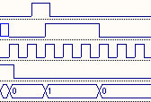
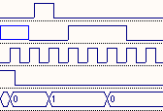
Example
...
module LaserTimer(B, X, Clk, Rst);
...
parameter S_Off = 0,
S_On = 1;
reg [0:0] State;
reg [1:0] Cnt;
always @(posedge Clk) begin
if (Rst == 1 ) begin
State <= S_Off;
Cnt <= 0;
end
else begin
case (State)
S_Off: begin
X <= 0;
Cnt <= 2;
if (B == 0)
State <= S_Off;
else
State <= S_On;
end
S_On: begin
X <= 1;
Cnt <= Cnt - 1;
if (Cnt == 0)
State <= S_Off;
else
State <= S_On;
…
B
X
Before
Clk
Rst
State
B
X
Clk
Now
Rst
State

Slide 9
One Procedure FSM Description
Likewise, can describe FSM using one procedure rather than two
  Same approach
  One variable for state (rather than two)
  One procedure, sensitive to clock only
Same issues as with HLSM
  Simpler, cleaner code: one procedure per FSM
  Timing may change: makes inputs synchronous, may introduce extra cycles

Slide 10
Verilog Functions
Returns a value to be used in an expression
This function named “ABS”
  Computes absolute value
  Returns integer value
  One input argument, integer
ABS can then be called by later parts of the description
…
input [7:0] A [0:255];
input [7:0] B [0:255];
output reg [31:0] SAD_Out;
integer Sum;
integer I;
function integer ABS;
input integer IntVal;
begin
ABS = (IntVal>=0)?IntVal:-IntVal;
end
endfunction
always begin
Sum = 0;
for (I=0; I<=255; I=I+1) begin
Sum = Sum + ABS(A[I] - B[I]);
end
SAD_Out <= Sum;
end
…

Slide 11
Event Control with an Expression
Uses @(Go==1)
  If Go not 1, wait until Go becomes 1
  Waits not just for change on Go, but for a change on Go such that Go equals 1
...
always begin
if (!(Go==1)) begin
@(Go==1);
end
Sum = 0;
for (I=0; I<=255; I=I+1) begin
Sum = Sum + ABS(A[I] - B[I]);
end
#50;
SAD_Out <= Sum;
end
...

Slide 12
More HLSM Examples
Inputs
: A, B [256](8 bits); go (bit)
Outputs
: sad (32 bits)
AB_addr
A_data
B_data
Local storage
: sum, sadreg (32 bits); i (9 bits)
i_lt_256
lt
A
cmp
B
9
8
8
S0
!go
i_ld
256
i
A
–
B
go
go
AB_rd
i_clr
S1
sum := 0
8
i := 0
S0
go
′
+ 1
S2
go
i<256
sum=0 sum_clr=1
sum_ld
S1
sum:=sum+abs(A[i]-B[i])
32
S3
i=0 i_clr=1
sum_clr
sum
abs
(i<256)’
i := i + 1
S2
32
32
8
S4
sadreg := sum
sadreg_ld
i<256 i_lt_256
sadreg
+
S3
sum=sum+abs(A[i]-B[i])
sadreg_clr
sum_ld=1; AB_rd=1
Datapath
32
i=i+1 i_ld=1
sad
(i<256)’ (i_lt_256)
S4
sad_reg = sum
sadreg_ld=1
Controller

Slide 13
Elapsed Time Calculation
Given an input button B, you are to calculate C, which is the number of cycles elapsed between 2 button presses. After C is calculated, the system returns to the Init state
You may not use a timer in your design

Slide 14
Elapsed Time Calculation HLSM
B’
B
B
Press1
Count := Count + 1
Wait
B’
B’
Init
B/W Presses
Count := 0
Creg := 0
Count := Count + 1
B
Press2
Creg := Count

Slide 15
Counter With Timer
Using a timer, design a system with a single-bit input buttons U and D, and a 16-bit output Q, which is initially 0. Pressing U increments Q, while D causes a decrement. Pressing U and Q at the same time causes Q to stay the same. If a single button is held down, Q continues to increment or decrement at a rate of once per second as long as the button is held. Q rolls over when the upper/lower value is reached.

Slide 16
Counter With Timer HLSM
U’
U
U * timer’
U’D’ + UD
PressU
WaitU
UD’
U * timer
U’
Qreg := Qreg + 1
timer_ld := ‘1’
timer_en := ‘1’
Init
Wait
D
D * timer’
Qreg := 0
U’D
D’
WaitD
D’
PressD
D * timer
timer_en := ‘1’
Qreg := Qreg - 1
timer_ld := ‘1’

Slide 17
Today’s Objectives
To become familiar with how to create an HLSM in Verilog
To gain more practice in designing an HLSM

Slide 18
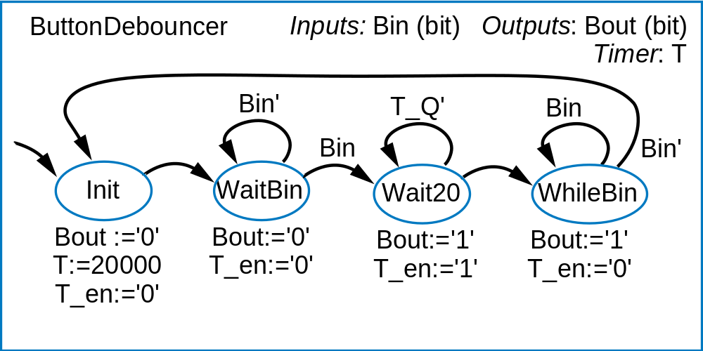
Question
What modification(s) would you need to make to the button debouncing HLSM if the time it takes to stabilize the output is longer than the time the button is pressed?
T_ld:=‘1’
T_ld:=‘0’

